Slide 1
T Level curriculum design
Catherine Sezen, AoC

Slide 2


USING TEAMS
1. Please put yourself on mute by clicking this button. This will help us to cut down on background noise (but don’t forget to take yourself off mute if you want to speak!).
2. If you’d like to raise a point during the meeting, please use the chat function to write your question, or raise your hand.
3. Please remember this session is being recorded so it can be shared with other providers.
We will do our best to resolve any technical issues as quickly as possible, and to answer all questions either now or at a later stage.
Some providers have reported problems with the chat function in Teams, please let us know if you have any issues Readiness.TE@education.gov.uk we can then investigate them.

Slide 3

T Level components
Core
Tutorial
assessment
English and maths
Industry placement
Occupational specialism

Slide 4


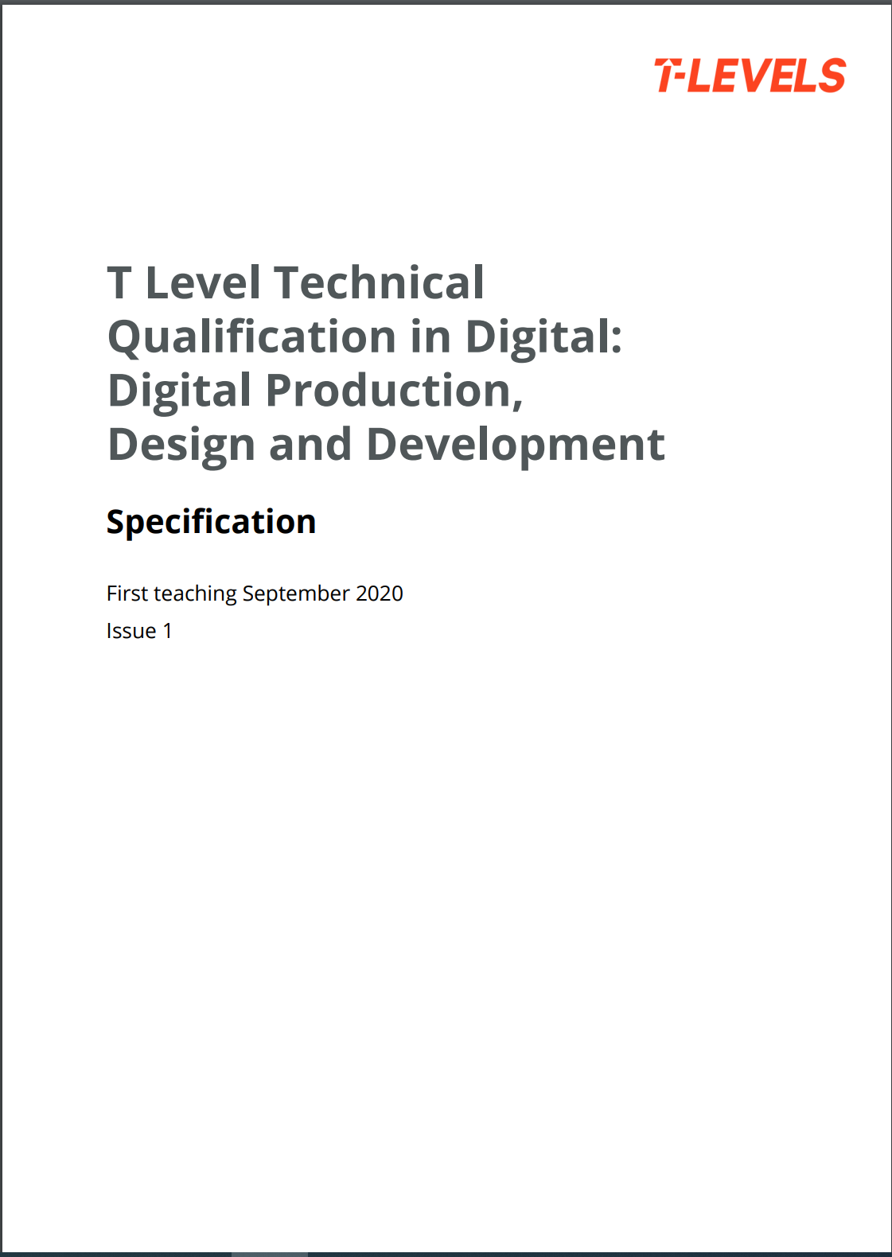
Course specifications

Slide 5
Design considerations

Slide 6
T Level programme
T Level programme
1800 Hrs over 2 years
TECHNICAL QUALIFICATION (TQ)
900 -1400 GLH
CORE
Up to half the qualification
Knowledge and understanding of the concepts, theories and principles relevant to that sector
Assessed through an external examination and a substantial project
Occupational specialism
At least half of the qualification
Knowledge and skills required to enter employment in that occupational specialism
As close to full competence as possible
English, maths and digital competence integrated where relevant
T Level Industry Placement
ENGLISH and maths Requirements
Students required to achieve a level 2 in English and maths.
Either GCSE (grade 4 and above) or level 2 Functional Skills (pass)
Additional mandatory requirements
Occupation-specific requirements, included where possible if essential to enter employment
Between 315-420 hours
Undertaken with an external employer
Chance to apply skills and apply knowledge in a workplace environment
Support for travel and subsistence costs but employers not expected to pay students

Slide 7
T Level Curriculum Design
Sequence of teaching, learning and assessment (both formative and summative) across the two years which supports student motivation and achievement.
For T Levels this may include consideration of:
employer taster days, visits and the industry placement in relation to when TQ components are taught and assessed;
students’ skills development over the two years to ensure they are properly prepared for the assessment
which occupational specialism
when to formatively assess students, and which academic year and series would be best to enter students for TQ summative assessments.
resource needs and utilisation over the two years; for example teaching, facilities and delivering Industry Placements.

Slide 8
Value of T Level ‘CUrrICULUM Design’
Considerations:
the sequence of delivery to support learning and attainment e.g. IP in relation to OS
the assessment key dates set by AOs and when to enter students for summative assessment
Core Knowledge
Learning/Assmnt/
Preparation
Exams
Employer Set Project
Learning/Assmnt/ Preparation
Summative Assessment
Industry Placement
Employability Skills Development
Technical Skills Development
Technical Skills Development
Occupational Specialism
Learning/Assmnt/Preparation
Summative Assessment
English
Learning/
Preparation
Exams
Maths
Learning/Preparation
Exams
MAR
Learning
Completion
Year 1
Year 2

Slide 9
Value of T Level ‘CURRICULUM Design’
Considerations:
the sequence of delivery to support learning and attainment e.g. IP in relation to OS
the assessment key dates set by AOs and when to enter students for summative
Core Knowledge
Learning/Assmnt/Preparation
Exams
Learning/Assmnt/ Preparation
Summative Assessment
Employer Set Project
Industry Placement
Employability Skills Development
Technical Skills Development
Technical Skills Development
Occupational Specialism
Learning/Assmnt/Preparation
Summative Assessment
English
Learning/Preparation
Exams
Maths
Learning/Preparation
Exams
MAR
Learning
Completion
Year 1
Year 2

Slide 10
Provider examples
Timetabling
Industry placement
Assessment
Occupational specialism
Resource implications
Key pinch points

Slide 11
Questions and comments
Please write a comment/question

Slide 12
A final thought…
Engagement and preparation with year 11 applicants:
Pre course work
Relevant documentaries/youtube clips etc
Getting to know you quizes

Slide 13
Thank you
Catherine.sezen@aoc.co.uk

Slide 14
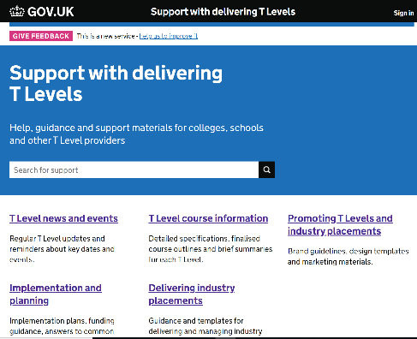
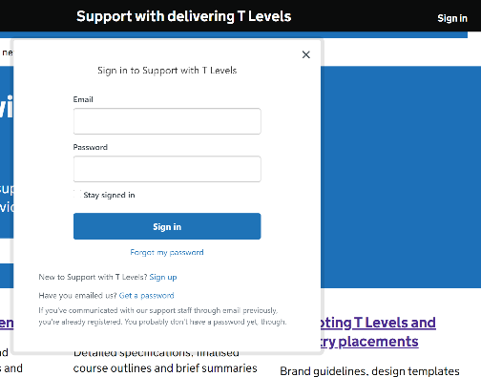
SUPPORT WITH DELIVERING T LEVELS WEBSITE
URL: https://support.tlevels.gov.uk/
Replaces old SharePoint site.
No limit to how many staff members sign up per college/school.
To sign up, click ‘Sign in’ at top right of main page (Pic 1), then ‘Sign up’ (Pic 2, below ‘Forgot my password’). Please contact support.deliveringtlevels@education.gov.uk if you experience any issues when using site.
Newsletter published fortnightly on Thursday evening – please check this for T Levels news and updates.

