Slide 1

An introduction to T Level Implementation Plans and Statistical Annexes for providers delivering T Levels in 2022
October 2020

Slide 2


USING TEAMS
Please put yourself on mute by clicking this button. This will help us to cut down on background noise (but don’t forget to take yourself off mute if you want to speak!).
If you’d like to raise a point during the meeting, please use the chat function to write your question.
Please remember this session is being recorded so it can he shared with other providers.
October 2020

Slide 3
Supporting you to plan for T Level delivery
Minimum termly conversations with your allocated ESFA contact who will provider support and challenge and answer questions
Opportunities for sharing practice and networking
Implementation plans to be completed twice a year in the run-up to delivery
Collecting information on planned delivery to ensure accurate T Level funding
T Level Professional Development Programme
Engagement with awarding organisations as qualifications are developed

Slide 4
Required Returns and Schedule for the Academic Year 2020 to 2021
Statistical Annex
T Level Implementation Plan
The information from the annex is used to inform funding allocations. It is also used to inform future T Level planning.
The plan provides prompts and support with your T Level implementation planning. It is also a means of the ESFA being able to gauge overall readiness to deliver T Levels
.
18 December 2020
The initial return of both the statistical annex and the implementation plan should be sent directly to your local ESFA lead by email copying in Statistical.ANNEXES@education.gov.uk.
3 May 2021
The second return of both the statistical annex and the implementation plan should be sent directly to your local ESFA lead by email copying in Statistical.ANNEXES@education.gov.uk.

Slide 5
T Level Implementation Plans
Overview

Slide 6
Completing the Position Fields
Description of your initial position
Students - We are planning a class size of 14 minimum in the first instance. The maximum will be determined by the physical resources required and space allocation. This will be monitored as recruitment and conversion continue. Students are likely to be a mix of new and progressing level 2 learners who are indicating capability to progress to level three and meet the entry criteria. New learners will be recruited mainly from the local school which does not have 16-19 provision. This will be subject to a normal college interview, to ensure "right student right course“. Students will be supported to remain on the course as normal, this will include allocating a personal tutor, target setting, access to college enrichment. A failure to recruit to minimum numbers will be reviewed in conjunction with ESFA advisor. A contingency for this could be to offer existing qualifications. The entry requirements are fit for the current level 3 offer but, they will need to be reviewed for the T Level.
In the position field, you should describe your current position and the reasons for the selected readiness rating.
Be as specific as you can and include any assumptions you may have had to make.
,
As a minimum you must cover your current position against the considerations listed in the considerations guide in the Completion Guidance and Support Document. You can also include other considerations that may apply to your institution. This is the consideration guide for the example above:
Students
• How many students do you need to successfully deliver this T Level route?
• What type of students will you be targeting?
• Will they be existing level 2 students or new students?
• Where will new students be recruited from
• What is in place to retain the students?
• What is the contingency if you do not recruit the needed number of students?

Slide 7
Rating Your Plan
Considerations: | Selected readiness rating: Initial return | Selected readiness rating: Final return
Management and Internal Communications | Actions identified | Plan progressed
Systems and Structure | Actions identified | Ready
Rating | Description | Example
Engaged | Our senior management team, governors and staff have received a briefing on the rollout. We have started to work to assess the impact on our provision. | Senior management, governors and staff have been briefed on T Level rollout. We have began a skills training analysis to identify support needed. We will begin to look at potential class sizes and models
Actions identified | We have conducted a thorough self-assessment of this category. We have identified the actions we need to take with the information currently available | We have conducted a self-assessment. We are aware of all the actions we need to take to implement T Levels at his time. We are looking at engaging with employers to upskill staff. We are awaiting further curriculum content to inform our plans on staffing resource.
Plan in place | We have a full development plan in place with detailed actions based on the information currently available. All actions have senior named owners. | We have a development plan in place signed off by senior managers. We have regular meetings for the owners of actions to update and report progress. We are engaging with employers for industry upskilling. We have completed our skills mapping using the curriculum content. We need some further funding information to begin planning any additional resource.
Plan being implemented | Our actions are progressing to be fully implemented in line with the T Level roll out timetable. | We are monitoring progress of all actions and are aware of any issues and have mitigated for these. We have began staff recruitment and all staff training, CPD and industry upskilling are scheduled.
Plan progressed | We have our infrastructure and staffing in place. We have all of the information we need. We are aware of every action we need to take to ensure delivery. | Our infrastructure and staffing are in place. We have all the information needed to complete the recruitment, training, CPD and industry upskilling. We are progressing our plans for support roles whilst on Industry Placement. At least 50% of our actions are completed.
Ready | We are ready for student enrolment and we are ready to implement T Levels. | Our enrolment processes are in place. The majority of our actions are completed and the others are nearing completion. Our recruitment is completed and staff have the necessary support to deliver T Levels.

Slide 8
Completing the Actions and On Track Fields
Actions to be completed | Responsible person | Target completion date | Actual completion date
Plan level 2 progression events | CM/Curriculum Lead | 05/01/21
Promote specifically at open evening events | CM/Curriculum Lead | 15/02/21
Monitor size of group and keep SLT appraised of number enrolled | Head of Faculty, SS | 01/02/21
Based on forecast numbers (offers made), advise SLT of any additional room requirements | Head of Faculty, SS | 01/02/21
Discussion with Faculty Management Group and teaching team on suggested entry requirements. | Head of Faculty, Assistant Principal | 01/12/20
Plan for at least two viable T Level groups | Head of Faculty, SS | 01/12/20
On track | Yes
In the ‘on track’ field please input yes or no to confirm whether overall you feel you are currently on track to implement T Levels on time. This means that you have completed everything you need to do currently and feel you have all further action planned and organised.

Slide 9
T Level Data Returns
Overview

Slide 10
Statistical Annex
What is a statistical annex and why do I need to return it?
The statistical annex is an excel spreadsheet issued to all providers approved to deliver T Levels.
The statistical annex spreadsheet is individual to each provider and is pre-populated with the student numbers that each provider entered in their 2022 T Level Expression of Interest earlier this year.
The spreadsheet is locked to the T Levels each provider has been approved to deliver.
The provider then uses this to enter projected learner numbers for T Levels, Transition Programmes and Specialisms that they have been approved to deliver.
What is the statistical annex used for?
It tells us who is delivering what – for planning, publication, support
The statistical annex return is used to inform providers’ indicative/final T Level funding allocations and enable providers to be funded upfront.
It is also used to report on T Level progress to Ministers, to identify good practice for sharing and to inform the content of T Level tools.

Slide 11
What information is required?
Look out for your copy
w/c 19 October
In December, providers will be asked to submit the following information;
T Level planned student numbers for the 2022/23 academic year (year 1 cohort)
T Level indicative student numbers on programme in the 2023/24 academic year (year 1 + year 2)
T Level indicative student numbers on programme in the 2024/25 academic year (year 1 + year 2)
Transition Programme planned learner numbers for the 2022/23 academic year (year 1 cohort)
Transition Programme indicative learner numbers on programme for the 2023/24 academic year (year 1 + 2)
Specialisms interest and projected figures for the 2022/23 academic year
As providers move closer to the year of delivery, the statistical annex requirement will be adjusted to reflect the essential data needed for allocations.

Slide 12
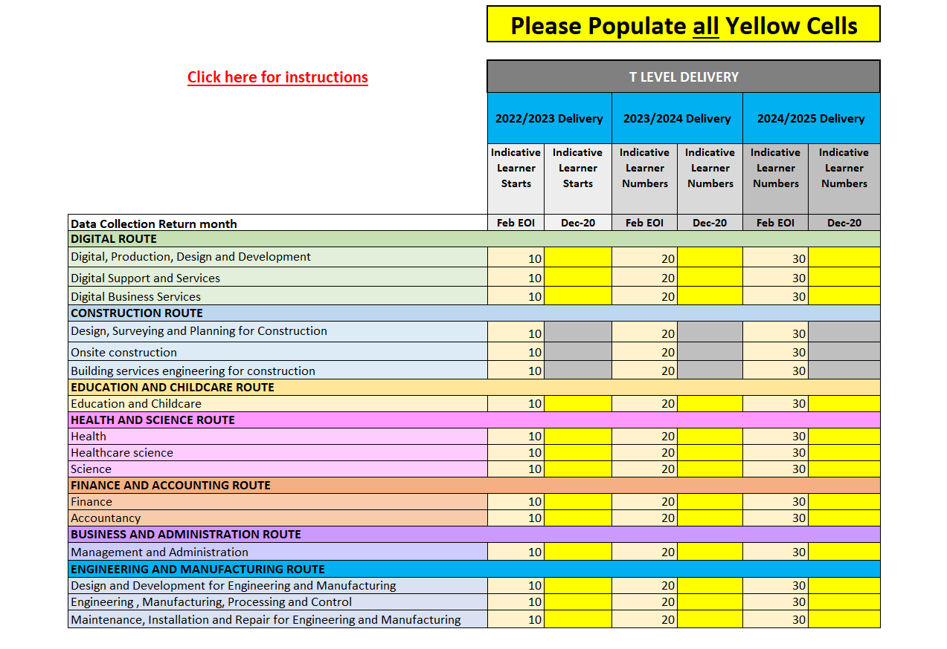
What does the statistical annex look like?
Pre-populated data from the provider Expression of Interest
Greyed out cells show where this provider is not approved to deliver the T Levely
Yellow cells should be completed and returned to the ESFAy

Slide 13
When and how is a statistical annex submitted?
The statistical annex is returned to the ESFA by 18th December 2020 (1st return only), then in May 2021, then in October 2021.
The ESFA use a dedicated mailbox statistical.annexes@education.gov.uk to issue the annexes to providers and to collect completed annexes.
What if I want to make a change?
If a provider wishes to make a change to T Level delivery plans, they have the facility to request this as part of each statistical annex return using the ‘T Level Change Request’ tab.
Change requests are reviewed against the published T Level student number eligibility criteria for delivering the additional T Level(s)
The May 2021 return is the last formal opportunity to add to the T Levels that you plan to deliver from the 2022/23 AY, although changes will be considered by exception until the end of September 2021, through the statistical annex mailbox.
How do I raise a question?
The ESFA use a dedicated mailbox statistical.annexes@education.gov.uk to issue the annexes to providers and to collect completed annexes.

Slide 14
Any Questions?

