Slide 1
T LEVELS digital services update
January 2021

Slide 2


USING TEAMS
1. Please put yourself on mute by clicking this button. This will help us to cut down on background noise (but don’t forget to take yourself off mute if you want to speak!).
2. If you’d like to raise a point during the meeting, please use the chat function to write your question, or raise your hand.
3. Please remember this session is being recorded so it can be shared with other providers.
We will do our best to resolve any technical issues as quickly as possible, and to answer all questions either now or at a later stage.
Some providers have reported problems with the chat function in Teams, please let us know if you have any issues Readiness.TE@education.gov.uk we can then investigate them.

Slide 3
T Level Results and Certification

Slide 4
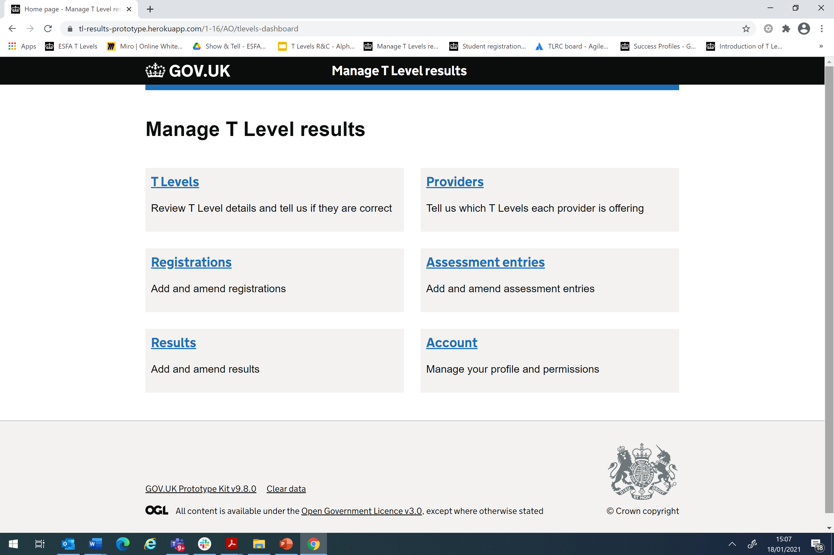
Manage T Level Results
A new digital service in development to collect T Level component results data, calculate overall T Level results and issue T Level certificates and statements of achievement
Both Awarding Organisations (AOs) and providers are required to use the service to support results calculation and certification of T Levels
The service will integrate with some existing DfE applications, including the Learning Records Service
The service is being developed incrementally, with an initial version launched to AOs in April 2020
Our full end-to-end service is due to be in place by August 2021

Slide 5
Manage T Level Results
high level service design and flow

Slide 6
What does this mean for T level providers?
Providers are required to provide student completion and attainment data on:
  Industry Placements;
  Mandatory Additional Requirements; and
  by exception, English and Maths for learners that qualified outside of England and Wales
Component data from providers is required to be input to the service before 31 July 2022 to ensure T Level grades are calculated and certificates issues
A Statement of Achievement will be issued to those students that leave the course early or do not pass all elements of their T Level
Important for providers to submit data as soon as it is available to enable the production of statements of achievement as necessary
T Level certificates and Statements of Achievement will be printed and sent to providers for issuing to students
Providers will therefore be required to confirm within the service an address where certificates and statements of achievement will be sent

Slide 7
Data requirements
The design of the service is being informed by research with providers to ensure it meets user needs
We will ensure providers will only input information that is essential for the service
As well as the Industry Placement completion status, for each student, providers will be required to confirm whether:
        A placement has been completed with special considerations
        Any allowable model has been adopted to deliver the placement
        The student has special educational needs or disability (SEND)
        The student has achieved the minimum requirements for Maths and English where they have studied outside of England or Wales
The service will be available to providers to request Statements of Achievement from August 2021, for students that leave the course early
We will continue to build on the service from September 2021, incorporating research with providers to ensure a user friendly experience

Slide 8
Support with delivering t levels

Slide 9
Next steps
Share best practice, ask questions!
If you have questions or issues relating to T Levels, try asking them on the forums!
Sign up for alerts!
Subscribe for alerts and get notified when there is an update or new content!
Give us feedback!
What content are we missing? What would you like to see more or less of?

Slide 10
Get involved in research
ESFA is developing a range of digital services to support providers and students in the delivery of T Levels.
We want to make sure that we design services that best meet your needs and would love to speak with you!
If you or your colleagues are able to contribute, or would like to know more about our research plans, please contact:
support.deliveringtlevels@education.gov.uk

