Slide 1


Manage T Level results

Slide 2
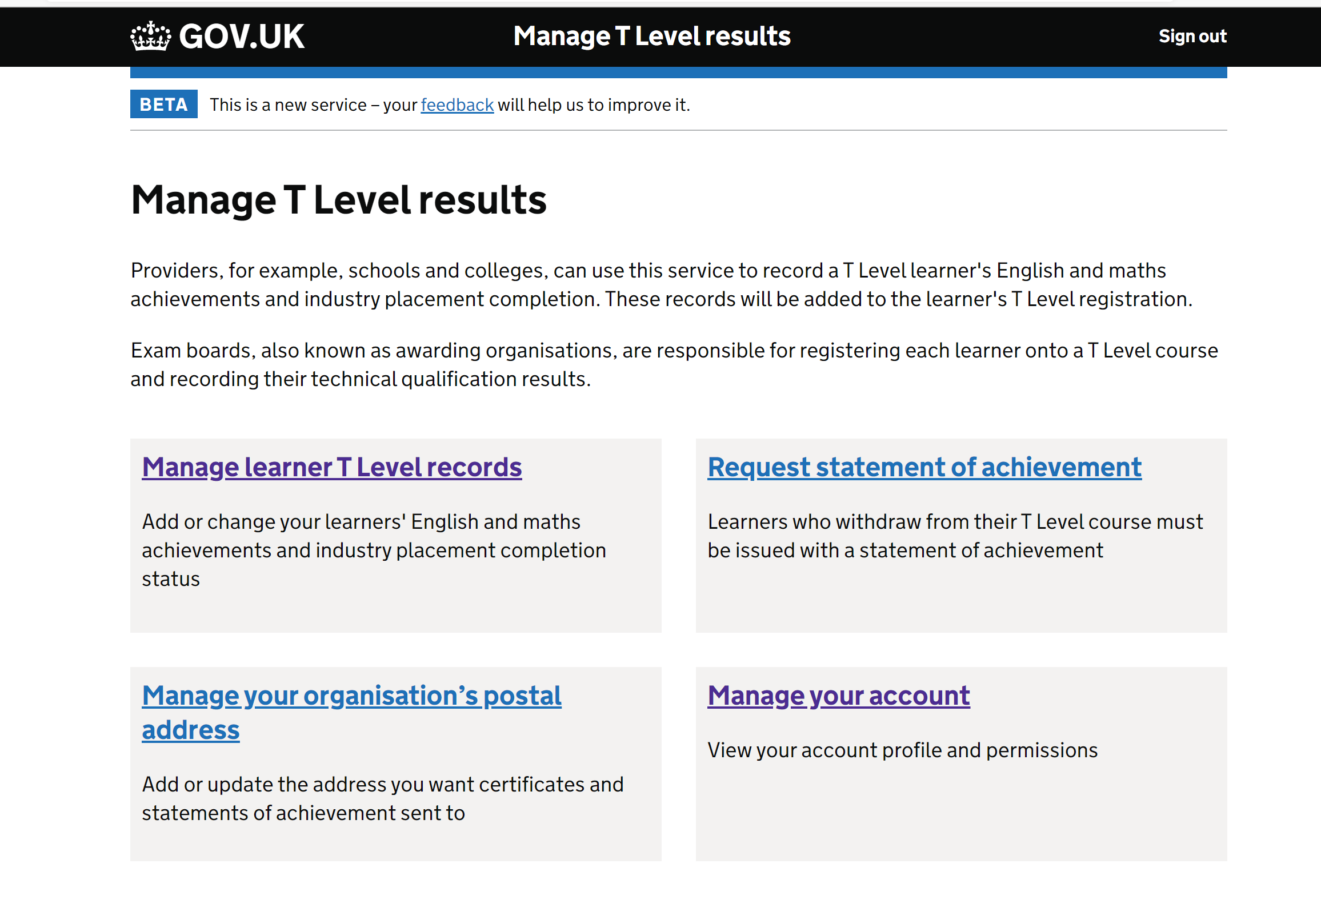
Service launched to providers
Manage T Level results service launched to providers on 23 June
Provider communications issued to support the launch, including email notifications, newsletters, and articles on our support service
This follows months of research-led design where we conducted two rounds of research with a range of provider types to ensure a user friendly experience
This is an initial version of the system for providers which will be enhanced over time
Awarding Organisations (AOs) are responsible for registering students in the system, including:
  Name
  Unique Learner Number
  Date of Birth
  T Level course
  Assessment Entries
It is essential that providers verify student attainment and completion of non-TQ components in order to support the calculation of overall results

Slide 3
High level Information Flow

Slide 4
Actions required in the service
Providers can only access information for students that have been registered with AOs
Providers are expected to provide confirmation of non-TQ component attainment:
  Industry Placement completions and;
  In some cases, English and Maths attainment
In the future, where Mandatory Additional Requirements are relevant, providers are also expected to verify the completion of these requirements in the system
Non-TQ component data must be entered by providers before 31 July 2022 to ensure T Level grades are calculated and certificates issued
A Statement of Achievement will be issued to those students that do not pass all elements of their T Level
Where students leave the course early, providers must inform the relevant AO of the student withdrawal, and then request a statement of achievement through the service
T Level certificates and statements of achievement will be printed and sent to providers for issuing to students
  Student registration information submitted to AOs will be used to populate certificates so it is essential that registration data is accurate
  In order to minimise burden to providers it is also important to ensure that Personal Learning Records in the Learning Records Service are accurate so that we can match student records and extract English and Maths attainment data

Slide 5
Demonstration of the service for providers
Recording English/Maths achievements and Industry Placement completions
Requesting Statements of Achievement

Slide 6
Next Steps
Minimum Viable Product to be completed by mid-August
Providers will be able to review component results and request statements of achievement for leavers from 10 August
From September we will need to prioritise key features such as the capture of occupational specialism data from AOs
Further development for provider aspects of the service are expected in early 2022
We will research with a range of providers to inform service design
Enhancements we expect to implement include the ability to submit data in bulk, as well as expanding Industry Placements section to capture delivery models being adopted

