Slide 1

Introduction to T Levels:
The Technical Qualification
19/11/2020 – Carmel Grant, Deputy Director Technical Education Implementation

Slide 2


USING TEAMS
1. Please put yourself on mute by clicking this button. This will help us to cut down on background noise (but don’t forget to take yourself off mute if you want to speak!).
2. If you’d like to raise a point during the meeting, please use the chat function to write your question, or raise your hand.
3. Please remember this session is being recorded so it can be shared with other providers.
We will do our best to resolve any technical issues as quickly as possible, and to answer all questions either now or at a later stage.
Some providers have reported problems with the chat function in Teams, please let us know if you have any issues Readiness.TE@education.gov.uk we can then investigate them.

Slide 3


The Institute
Founded in 2017, the Institute for Apprenticeships & Technical Education (“the Institute”) plays an active role in ensuring high quality technical education.
The Institute is an employer led crown Non-Departmental Public Body.
The Institute is responsible for Apprenticeship Standards and Technical Qualifications
Technical Qualifications are the main, classroom-based element of the T Level. T Levels are two-year technical study programmes that will become one of three major options for students to study at level 3 alongside Apprenticeships and A Levels.
The Institute is passionate about delivering quality apprenticeships and technical education to support employers, potential apprentices and the economy as a whole

Slide 4

What are T Levels?
T Levels will combine classroom theory, practical learning and a 3 month industry placement with an employer to make sure students have real experience of the workplace.
They provide the knowledge and experience needed to open the door to highly skilled employment, an apprenticeship or higher level study.
T Levels are new courses from September 2020, which will follow GCSEs and will be equivalent to three A Levels.
The 2 year T Levels courses have been developed in collaboration with employers and businesses so that the content will meet the needs of industry and prepare students for work.
Notes:
Animation - Grow

Slide 5
T Level Programme
Responsibilities for the T Level Programme are detailed below:
T Levels
Institute for Apprenticeships & Technical Education
Department for Education
The Technical Qualification (TQ)
Industry Placements & Transition Programme
TQ Responsibilities
Creation of Outline Content
Procurement of Awarding Organisations
TQ Development
Institute Approval
Ofqual Accreditation
Contract Management

Slide 6







































Outline Content - T Level Panels

Slide 7

Procurement
2020 T Level ITT published
Evaluation of bids
Contracts Awarded
Content development period
Provider readiness
Sept’ 2020:
Teach date for
T Levels
Autumn 2018
Winter 2018 Spring 2019
Spring 2019 – Early 2020
Early 2020 – Autumn 2020
2021 T Level ITT published
Evaluation of bids
Contracts Awarded
Content development period
Provider readiness
Sept’ 2021:
Teach date for
T Levels
Spring 2019
Summer 2019
Autumn 2019
Autumn 2019 – Autumn 2020
Autumn 2020 – Autumn 2021
2022 T Level ITT published
Evaluation of bids
Contracts Awarded
Content development period
Provider readiness
Sept’ 2022:
Teach date
T Levels
Spring 2020
Summer 2020
Autumn 2020
Autumn 2020 – Autumn 2021
Autumn 2021 – Autumn 2022
2023 T Level ITT published
Evaluation of bids
Contracts Awarded
Content development period
Provider readiness
Sept’ 2023:
Teach date
T Levels
Autumn 2020
Spring 2021
Summer 2021
Summer 2021 – Autumn 2022
Autumn 2022 – Autumn 2023
Notes:
Prov new w4 timings

Slide 8
Developing the TQ
T Levels are a collaborative process:
‘Owners’ of the policy as a whole.
On-the-ground implementation
DfE/ESFA Input
‘Providers’
T Levels
A quality product
AOs
Developing and delivering TQs
Institute & Employers
Implementing relevant, engaging Standards which meet the needs of employers, and ensuring a quality product.
Ofqual
Regulation

Slide 9
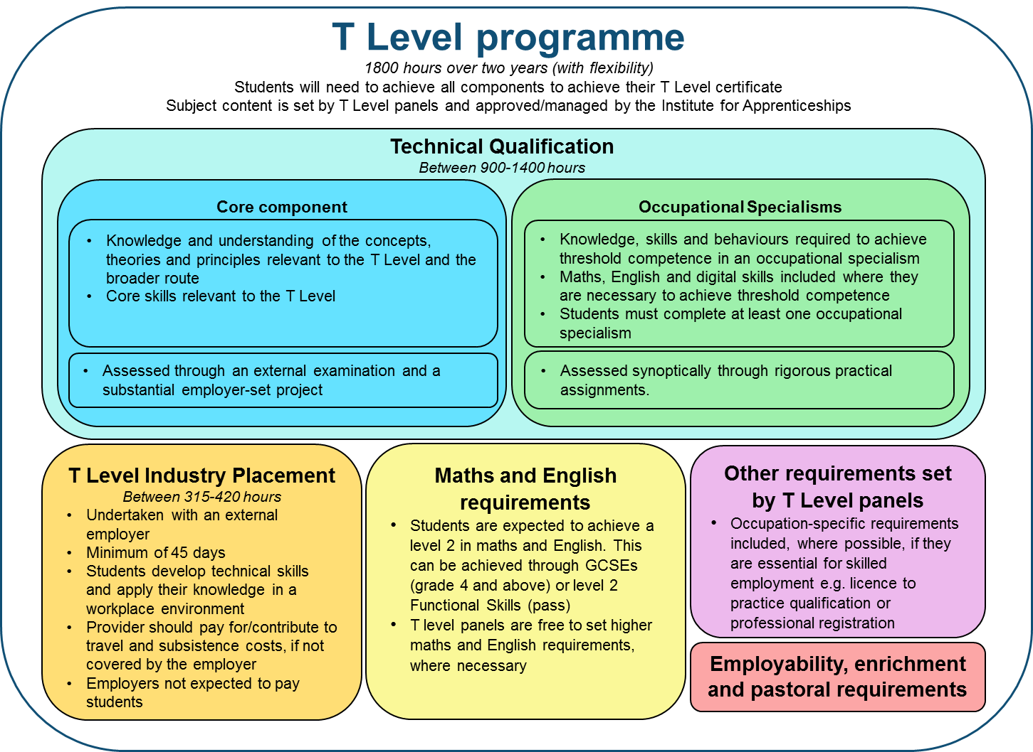
The Structure of T Levels
The TQ is the area which the Institute will be managing, and where the AOs will have direct involvement.

Slide 10
Technical Qualification:
Example Structure - Construction
Core: Design Surveying and Planning for Construction (GLH e.g. 540 hours)
Occupational Specialisms (GLH e.g. 540 hours)
Surveying and design for construction and the built environment
Core Knowledge and Understanding (e.g. 360 hours)
Employer-Set Project
(e.g. 180 hours)
Civil engineering
Building services design
20% - 50% of the TQ
Hazardous materials analysis and surveying
50% - 80% of the TQ
Students must take both parts of the core.
The GLH above is indicative, actual Guided Learning Hours can be found in the qualification specification
Students typically take one occupational specialism. Some TQs may require two.

Slide 11



Wave 1 of T Levels
Here are the three T Levels which were launched September 2020, as part of Wave 1.
T Level in Design, Surveying and Planning for Construction
T Level in Education and Childcare
T Level in Digital Production, Design and Development

Slide 12
Wave 2 of T Levels
Wave 2 (2021) will see the following T Levels introduced.
T Level in Healthcare Science
T Level in Building Services Engineering for Construction
T Level in Digital Business Services
T Level in Health
T Level in Onsite Construction
T Level in Digital Support Services
T Level in Science

Slide 13

Wave 3 of T Levels
Wave 3 (2022) will see the following T Levels introduced.
T Level in Maintenance, Installation and Repair for Engineering and Manufacturing
T Level in Accounting
T Level in Engineering, Manufacturing, Processing and Control
T Level in Finance
T Level in Design and Development for Engineering and Manufacturing
T Level in Management and Administration

Slide 14
Wave 4 of T Levels
Wave 4 (2023) will see the following T Levels introduced.
T Level in Animal Care and Management
T Level in Catering
T Level in Craft and Design
T Level in Agriculture, Land Management and Production
T Level in Hair, Beauty and Aesthetics
T Level in Media, Broadcast and Production
T Level in Human Resources
T Level in Legal

Slide 15
Awarding Organisation: Key Dates and Events
DATE | City & Guilds | NCFE | Pearson
12/11/2020 |  |  | Digital Q&A Network Sessions 4:00pm-5:00pm Register - Digital: 12 November 4pm
18/11/2020 | T Level Provider Welcome Webinar - Management & Administration 9:30am-10:30am Register now
19/11/2020 |  |  | Construction Q&A Network Sessions 4:00pm-5:00pm Register - Construction: 19 November 4pm
09/12/2020 | Construction and BSE - T Level Occupational specialisms introduction. 1:30pm-2:30pm. Register now
06/01/2021 |  | Delivering T Levels with NCFE: An introduction for 2022 providers 12:00pm– 1:00pm Register:https://attendee.gotowebinar.com/register/863395215147770126

Slide 16
Awarding Organisation: Information
City & Guilds
Information for providers: https://www.cityandguilds.com/tlevels/providers
T Level events and webinars:
https://www.cityandguilds.com/tlevels/events
Wave 3: Accounting and Finance
Pearson are seeking Expressions of Interest from Providers who would like to join their Provider Validation Panel (PVP).
To become a member, you must:
be intending on delivering either the Accounting and/or Finance in September 2022.
be experienced in delivering Accounting and/or Finance qualifications/units.
be able to attend PVP meetings (these will be remote, via teams or zoom) to discuss content, assessment, manageability, resources etc.
Let us know if you want to join the PVP
NCFE
Information for providers:
https://ncfe.org.uk/t-levels/providers
Pearson
Information for providers:
https://qualifications.pearson.com/en/qualifications/t-levels/faqs.html
Training Archive:
https://qualifications.pearson.com/en/qualifications/t-levels/t-levels-for-educators.html

Slide 17












The Road Ahead: 2020 to 2023
 | Route | Pathway | Delivery | AO
 | Construction | Design, Surveying and Planning for Construction | 2020 | Pearson
 |  | Onsite Construction | 2021 | City & Guilds
 |  | Building Services Engineering for Construction | 2021 | City & Guilds
 | Education & Childcare | Education and Childcare | 2020 | NCFE
 | Digital | Digital Production, Design and Development | 2020 | Pearson
 |  | Digital Support Services | 2021 | NCFE
 |  | Digital Business Services | 2021 | NCFE
 | Health & Science | Health | 2021 | NCFE
 |  | Healthcare Science | 2021 | NCFE
 |  | Science | 2021 | NCFE
 | Legal, Finance & Accounting | Legal | 2023
 |  | Finance | 2022 | Pearson
 |  | Accounting | 2022 | Pearson
 | Engineering & Manufacturing | Design and Development for Engineering and Manufacturing | 2022 | City & Guilds
 |  | Maintenance, Installation and Repair for Engineering and Manufacturing | 2022 | City &Guilds
 |  | Engineering, Manufacturing, Processing and Control | 2022 | City & Guilds
 | Business & Administration | Management and Administration | 2022 | City & Guilds
 |  | Human Resources | 2023
 | Hair & Beauty | Hair, Beauty and Aesthetics | 2023
 | Creative & Design | Craft and Design | 2023
 |  | Media, Broadcast and Production | 2023
 | Catering & Hospitality | Catering | 2023
 | Agriculture, Environmental & Animal Care | Animal Care and Management | 2023
 |  | Agriculture, Land Management and Production | 2023

Slide 18
Further information
For more information please visit:
https://www.instituteforapprenticeships.org/t-levels/
https://www.tlevels.gov.uk
https://www.gov.uk/government/publications/introduction-of-t-levels/introduction-of-t-levels
https://support.tlevels.gov.uk/hc/en-gb
Follow our social media accounts:
https://twitter.com/IFAteched
https://uk.linkedin.com/company/instituteforapprenticeships
https://apprenticeships.blog.gov.uk/

Slide 19

Questions

Slide 20
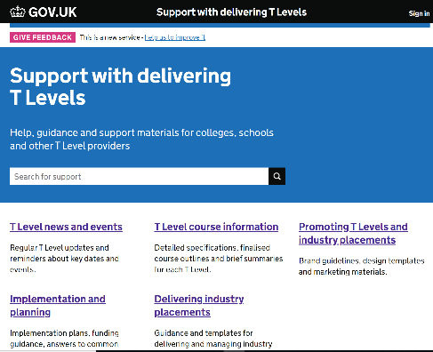
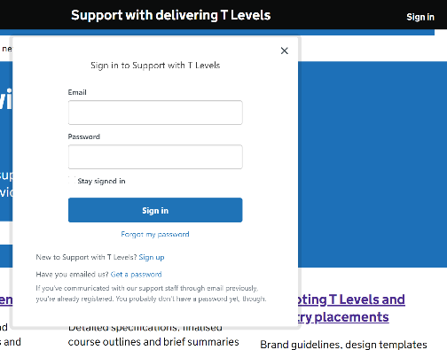
SUPPORT WITH DELIVERING T LEVELS WEBSITE
URL: https://support.tlevels.gov.uk/
Replaces old SharePoint site.
No limit to how many staff members sign up per college/school.
To sign up, click ‘Sign in’ at top right of main page (Pic 1), then ‘Sign up’ (Pic 2, below ‘Forgot my password’). Please contact support.deliveringtlevels@education.gov.uk if you experience any issues when using site.
Newsletter published fortnightly on Thursday evening – please check this for T Levels news and updates.

