Slide 1
INDUSTRY PLACEMENTS

Slide 2


USING TEAMS
1. Please put yourself on mute by clicking this button. This will help us to cut down on background noise (but don’t forget to take yourself off mute if you want to speak!).
2. If you’d like to raise a point during the meeting, please use the chat function to write your question, or raise your hand.
3. Please remember this session is being recorded so it can be shared with other providers.
We will do our best to resolve any technical issues as quickly as possible, and to answer all questions either now or at a later stage.
Some providers have reported problems with the chat function in Teams, please let us know if you have any issues Readiness.TE@education.gov.uk we can then investigate them.

Slide 3
CONTEXT - THE T LEVEL PROGRAMME
80%
Up to 1400 hours
TECHNICAL QUALIFICATION
Core
English and maths
Occupational
specialism
Other requirements
2 years
20%
At least
315 hours
350 hours average
Technical skills and knowledge
Practical skills for employment
Meaningful contribution in the workplace
INDUSTRY PLACEMENT
Notes:
Let’s look inside what makes up a T Level
The Technical Qualification is made up of a Core and an Occupational specialism. There are a very wide range of specialisms available in construction reflecting the diversity of careers in the industry
Core
The Core Component provides a high-level foundation of knowledge and skills that are relevant to all Occupational Specialisms.
The Core will be assessed through an exam and a project
Occupational specialism
Students choose a specialism.
They will learn and be assessed on the knowledge and skills needed to do a specific job through assignments and tasks, which might be part of the industry placement
The specialism is at least half the total qualification
English and Maths
Student needs Level 2 in both to pass their T Level
Other requirements
The employer panels who designed the T Level, included specific requirements and accreditations that students will need in the workplace, again getting them ready for work. These could include additional training, certificates or memberships
You can see the Industry placement there which is at least 20% of the programme and we already talked about its requirement to be meaningful and how it will help students to apply knowledge and develop practical and employability skills.

Slide 4
Why Industry Placements?
Current 1-2 weeks work experience are not specific to a student’s course, so don’t enable students to develop technical skills employers need.
Some students would prefer a high quality classroom-based practical alternative to the academic route and may not feel ready to leave an education setting to take an apprenticeship but prefer this practical mode of learning.
The substantive industry placement is a big challenge but is also the unique selling point of the T Level.

Slide 5

WHAT ARE INDUSTRY PLACEMENTS?
Time spent by a 16-19 year old student, learning and working in an organisation
In a real environment – with an employer making a meaningful contribution to the organisation
Minimum of 315 hours (approx. 45 working days) –average 350 hours.
Occupationally-specific – developing students’ practical and technical skills
Placements can be in single block, day release or a mix of the two.
Notes:
So what are industry placements?
‘Industry placements’ is a specific term – so let’s describe what they are and also what they aren’t.
They are for 16-19 year old students who are in full time education spending time in an organisation like yours, learning and working.
It is about working in a real environment within a department or team with support to make a meaningful contribution. This is a two-way engagement. Its not just focused on what the student gains; it recognises that a key outcome is they have structured work that can have impact for you in the short term as well as the longer term potential of that young person joining you in future.
Diving into T Level territory briefly here. An industry placement is a minimum of 315 hours which is approximately 45 working days.
Our focus is on student’s practical and technical skills. This includes employability skills that employers have told us over and over again are key; the behaviours and attitudes young people present from the outset and what they learn as they progress through their placement and programme of study.
As you can see, they are different to, but can work alongside, apprenticeships

Slide 6
What an induSTRY PLACEMENT should offer
A high quality industry placement should:
Give a student a chance to put into practice Level 3 technical skills that they have learnt as part of their T Level, developing and honing the knowledge and skills they need to progress.
Give students credibility with prospective employers
Improve a student’s confidence, competence and employability
Give the employer the opportunity to develop and shape young people’s skills to build their future workforce to meet their needs, as well as seeing what the young person is capable of before potentially taking then on as an apprentice or an employee
Give an opportunity for the provider to ensure that the course equips students with the skills employers are look for and are ready for the working world.

Slide 7
Developing Industry Placements
We have carried out extensive user centred research and analysis – listening to the sector to understand their concerns
This has been backed up with significant engagement– working with employers, providers and students to shape the policy evidence base and identify best practice and challenges to delivering industry placements
Industry Placement Pilot Scheme (led by The Challenge)
The industry placement pilot scheme tested different models and approaches to delivering T Level placements in academic year 2017/18. 21 providers piloted these, successfully enabling over 1,100 placements to be completed
An independent evaluation of the pilots was published in December 2018. A key message was that ‘one size doesn’t fit all’, and models need to vary between industry, course and employer type

Slide 8
Key challenges
One size doesn’t fit all – aware that there are differing workplace practices across industries, and students have different backgrounds and personal circumstances
Encouraging employers to offer placements – providing support for employers to be able to offer placements, understanding the multiple asks government has of them to offer differing forms of work related training
Ensuring accessibility of placements – many businesses are in remote areas or rural areas
Health and safety /security clearance – students often require security clearance to access ties, especially engineering and construction.
Financial and resource costs to employers – identifying and overcoming the cost to employers of hosting a student including equipment, liability insurance and more

Slide 9
RESPONDING TO THE CHALLENGES – MODELS
Models to help ensure placements are high quality, meaningful, deliverable across different industries and accessible for all students:
Allowing students generally to work with up to 2 employers
Using on-site facilities for SEND students for part of the placement, and for all of the placement for those in Young Offenders Institutes.
Allowing a small proportion of occupationally relevant work tasters to count towards placement
Allowing part time work to count as long as it is occupationally relevant and at the right level
Placements recorded in hours rather than days - to reflect different working practices
Some route-specific models to reflect different industries including:
    For Digital and Engineering and Manufacturing: allowing placements at route level (as opposed to those only relevant to their particular occupational specialism)
    For Construction and Engineering & Manufacturing: allowing one lead employer to facilitate the full 315 hours placement across their subcontractors or supply chain to ensure students have experience of the whole range of tasks required on projects

Slide 10
RESPONDING TO THE CHALLENGES – SUPPORT
Provided nearly £115m in capacity and delivery funding (CDF) to providers to help them establish the infrastructure and resources needed to deliver industry placements since 2018/19, with approximately £52m more available in 20/21
The National Apprenticeship Service is providing a referral and matching service to make it easier for employers to be put in touch with local providers – NAS has engaged with over 16,000 employers
An employer support package launched, comprising online guidance, case studies and workshops to help employers to host high-quality industry placements
£7m employer support fund pilot is testing the impact of funding on employers’ willingness to offer placements, with CDF providers from four regions invited to take part in the pilot
Civil service and public sector – co-ordinating Industry placements across Departments, and working with public sector organisations such as the LGA to support IP provision.
Industry Placements Delivery Guidance for providers and employers published – including a student guide to help them prepare
To improve access the NAS has been looking to secure more SMEs as they predominate in rural areas, we have increased bursaries for travel and identified imaginative approaches to travel which we will look to promote widely.
We have appointed an organisation to support 2020, 2021 and 2022 providers to help them deliver high-quality placements in line with the delivery guidance.

Slide 11
Covid 19
We are fully aware that COVID-19 is having an impact and will continue to do so on delivery of placements
We are not proposing any further changes to the policy yet – we do not want to make knee jerk changes that could compromise the quality of industry placements - important we don’t jump the gun until we are clear on how COVID 19 will impact longer term
We are working closely with providers to listen to their feedback and understand the likely delivery challenges
And we will continue to review the impact throughout the Autumn term to see if we need to go further with any support

Slide 12
Resources
NAS helpline: 08000 150 600
Industry Placements Policy Statement https://www.gov.uk/government/publications/industry-placements-policy-framework
Industry Placement guidance / resources (hosted on the AoC website)
https://www.aoc.co.uk/industry-placements-guidance-resources
Industry Placement case study videos on YouTube
https://www.youtube.com/playlist?list=PL6gGtLyXoeq-rt4HRUDy_MY77BEH7r9Rc
Industry Placement Delivery Guidance
https://www.gov.uk/government/publications/t-level-industry-placements-delivery-guidance
T Levels Employer Support website
https://employerindustryplacements.co.uk/
DFE industry palcmet ment team

Slide 13
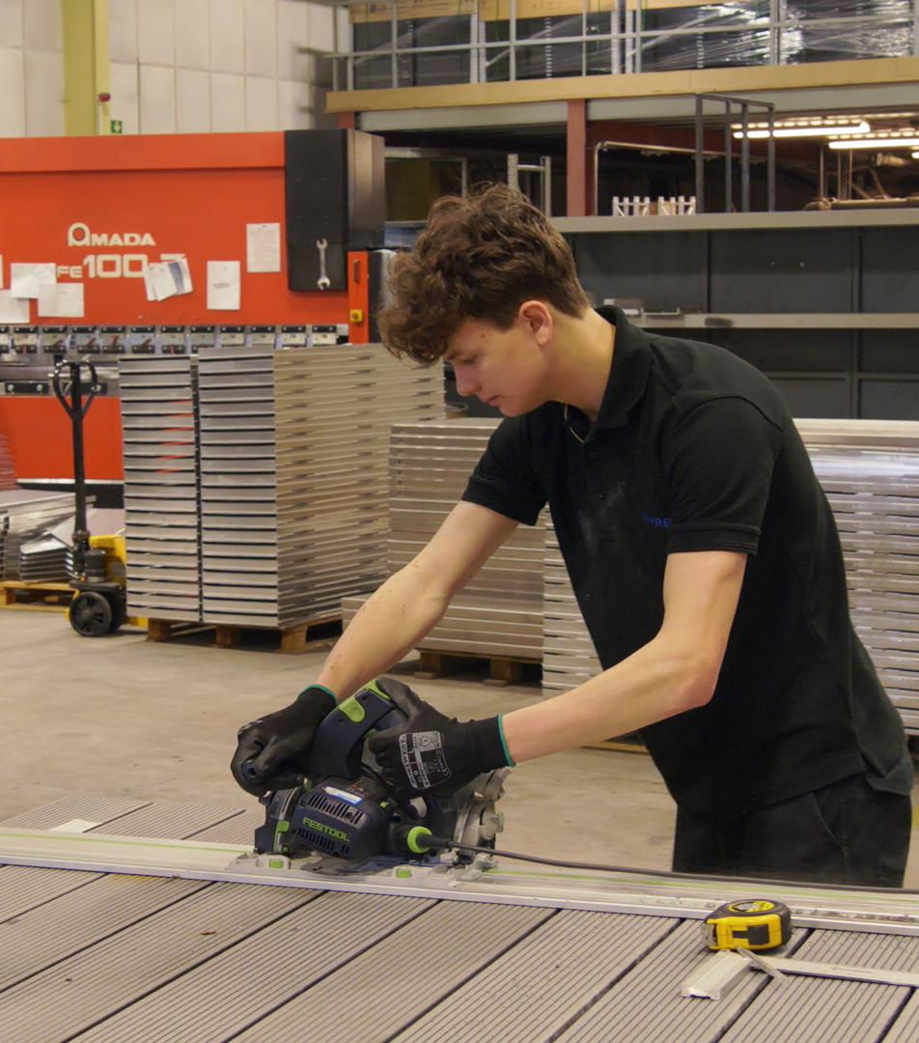
QUESTIONS
For any follow up questions, please contact the industry placements policy team at:
industry.placements@education.gov.uk

Slide 14
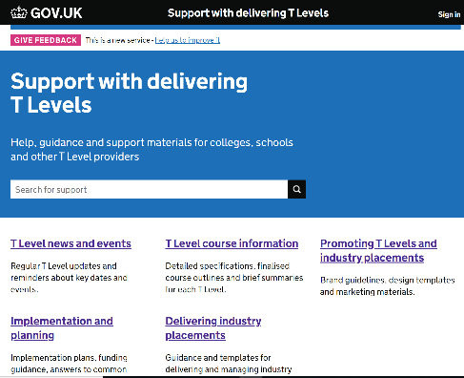
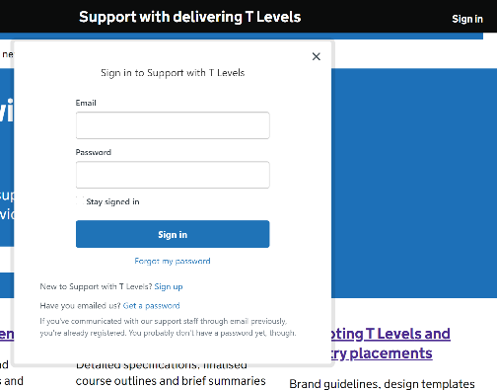
SUPPORT WITH DELIVERING T LEVELS WEBSITE
URL: https://support.tlevels.gov.uk/
Replaces old SharePoint site.
No limit to how many staff members sign up per college/school.
To sign up, click ‘Sign in’ at top right of main page (Pic 1), then ‘Sign up’ (Pic 2, below ‘Forgot my password’). Please contact support.deliveringtlevels@education.gov.uk if you experience any issues when using site.
Newsletter published fortnightly on Thursday evening – please check this for T Levels news and updates.

