Slide 1
Industry placements launch event - presentation template
Context
The following presentation template includes information for students, staff and employers. When using this template, please select the slides most relevant to your audience.
The template provides overview content which is not intended to be used in full during a presentation. Once you are familiar with the content, text on slides should be cut to include only headline information, relevant to the audience.
Additional case studies are available online in a range of subjects. Please include relevant case studies to your audience.

Slide 2
industry placements launch event

Slide 3
About industry placements

Slide 4
context
Two-thirds of businesses found relevant work experience either critical or significant in candidates when recruiting. Work experience is an important facilitator for young people entering, and succeeding, in the workplace. Around two-thirds (65%) of employers reported that relevant work experience was a critical or significant factor when taking on (any aged) recruit. (Source: Employer Perspectives Survey 2016.)
Current 1-2-week work experience placements, which are not specific to a student’s course, don’t enable students to develop the technical skills that employers need, meaning there are critical skills shortages in the economy. That is why the Department for Education (DfE) made a commitment that all 16 to 19-year-old students following a new technical education route will be entitled to a quality industry placement to arm them with the technical skills they need to give them the best possible chance for entering skilled employment.

Slide 5
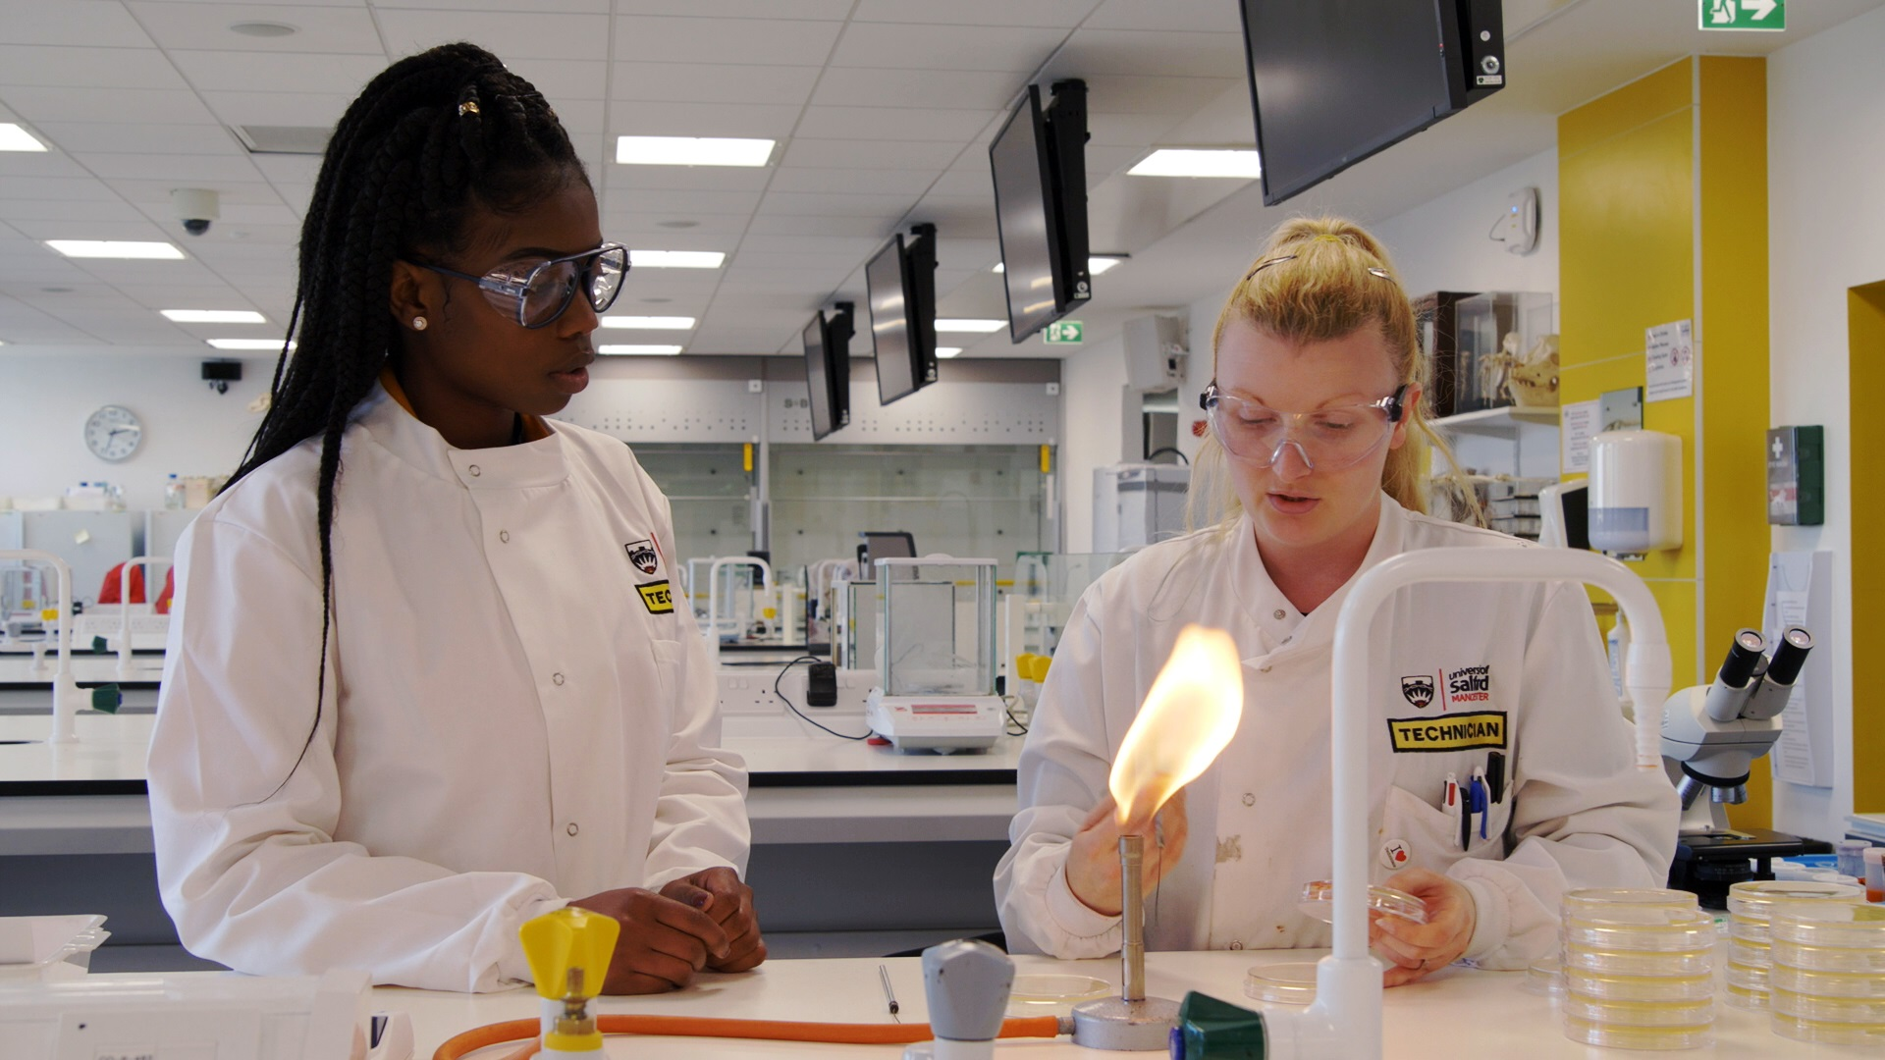
context
Industry placements will be a mandatory part of new T Levels. T Levels are rigorous, classroom-based, technical study programmes at level 3, designed to support entry to skilled employment in technical occupations at level 3 and above.
A substantial, high quality industry placement with an external employer will be an essential part of each T Level.
To prepare for T Levels, we are starting to implement industry placements across some of our courses this year.

Slide 6
Essential information
You’ll spend a minimum of 315 hours (45-50 days on average) with an external employer in a role directly relevant to your course.
The placement will be a good fit with your course, meaning you’ll be able to learn the relevant technical skills for your industry.
You will have to travel to the employer’s premises instead of to college/school during this time. If you are eligible for support for expenses such as travel and subsistence you will continue to receive it. If you do not currently receive this support but are concerned about or unable to cover any additional costs, please let us know.
Some employers may pay a wage or cover your expenses.
The placement will take place during [insert term], from [insert date] for [x] days, over [x weeks].
It is essential that students complete their placement. This is a vital part of their learning programme and will prepare them for their next step/the workplace.

Slide 7
Benefits of an industry placement
Build and develop technical skills, increasing competence and ability to progress into skilled employment.
Further develop “soft skills” such as communicating, teamwork and problem solving.
Gain deeper knowledge of the running of a business and general commercial principle.
Opportunity for personal growth: develop self-reliance, step out of your comfort zone and build confidence. Identify your strengths and preferences for future career options.
Potentially secure a job or apprenticeship with the employer afterwards and on completion of your course (this was the case for several students involved in the pilot last year).
Build a valuable working relationship with an employer, resulting in a more meaningful reference to use for future job applications.

Slide 8

What students say
Watch this short video of a group of students who completed their industry placement.

Slide 9
Industry placement case studies
The Department for Education launched 13 video and 11 written case studies, which are available online.

Slide 10

Creative
Phoebe enjoyed her placement at Radio Norfolk, where she wrote, edited and presented her own reports.

Slide 11

construction
Najeeb and Raihan gained a real insight into construction through their industry placements with Gulliford Try Partnerships.

Slide 12

Hair and beauty
Brooke and Maisy loved their industry placements as Daniel Galvin and now have full time jobs at the salon.

Slide 13

Digital
Stan’s industry placement at Norfolk County Council allowed him to use his digital skills in real projects.

Slide 14
Industry placement Timeline for students

Slide 15
Detailed timeline for students (1)
Timing | Task
At least 2 months before placements start | Attend presentation to learn about industry placements
At least 2 months before placements start | Notify and inform parents/guardians about industry placements
At least 2 months before placements start | Discuss your interests, skills, any potential barriers (part-time jobs, caring responsibilities) with the industry placements team to allow them to match you (and notify the team if you’re contacting employers yourself)
At least 2 months before placements start | Attend preparation sessions
At least 2 months before placements start | Write your CV, prepare for interviews, and get any necessary certification that may be applicable to your industry, with support from tutors
At least 2 months before placements start | Contact any employers you’re interested in and apply

Slide 16
Detailed timeline for students (2)
Timing | Task
At least 2 months before placements start | Notify the industry placements team about employers you have been in touch with
2 months before placements start | Receive list of suitable employer(s) for your industry placement and choose which you’d like to be matched with
1-2 months before placements start | Do employer assessment/interview (if applicable)
1-2 months before placements start | Give the industry placements team your employer preferences, if you’ve been matched with more than one
2-6 weeks before placements start | Find out which industry placement you have been matched with
2 weeks before start date | Attend an industry placement agreement meeting with your tutor and employer (and your parent/guardian if necessary)

Slide 17
Detailed timeline for students (3)
Timing | Task
Up to 2 weeks before start date | Do any training required by your employer
 | Start your industry placement!
Ongoing | Schedule regular one-to-one meetings with your line manager, throughout the placement and your tutor or industry placement contact at your education provider.
During placement | Attend your review meetings
End of placement | Follow up with your employer to thank them and ask for a reference
End of placement | Complete feedback on the employer

Slide 18
Responsibilities of the education provider, employer and student
NOTE: Pick which sections to include based on the relevance to the audience of the event, i.e. staff or students.

Slide 19
Responsibilities: education provider
Pre-placement
Ensure the industry placement is good quality, safe, meets the students’ learning aims, and that any necessary checks are carried out on the employer before the student goes on their industry placement.
These checks may include a site visit and a questionnaire to check basic adherence to health and safety, the existence of appropriate policies on insurance and safeguarding, etc. and a suitable induction process, supervision and provision for students with SEND or LLDD.
Ensure that the industry placement provides the opportunity for the student to apply and develop technical skills that are related to their occupational field of study.
Communicate any special requirements of the student to the employer.
Agree with the student and the employer a set of learning objectives to be achieved on the industry placement.
Agree and sign a three-party industry placement agreement with the employer and the student.

Slide 20
Responsibilities: education provider
Student preparation
Train students on professional etiquette and expectations before they go on the work placement.
Provide information to the student on general health and safety issues prior to their placement.
Provide any specialist guidance and information to students with any additional needs, e.g. special educational needs and disabilities (SEND) / learners with learning difficulties or disabilities (LLDD) and provide specialist guidance and information to employers hosting any such students.
Liaise with the employer to ensure the student is equipped with any materials and support required for the performance of the placement such as personal protective equipment (PPE).
Provide students with a log book to track their industry placement activities and progress.

Slide 21
Responsibilities: education provider
During the placement
Maintain regular contact with the employer and the student during the placement to monitor and evaluate the placement in terms of the student’s progress as well as health, safety and welfare. Agree frequency of contact with the employer. Contact with the student should be fortnightly as a minimum.
Organise a mid-point review between you, the student and the employer. This should be held in person and is an opportunity to check in with the student’s progress, review their learning objectives and make any changes to improve the second half of the placement.
Carry out ongoing safeguarding checks as necessary to ensure the safety of the student whilst working with the employer. Education providers will use reasonable discretion in considering the track record and experience of employers to determine the level of monitoring they may need.
If any serious issues arise relating to the student’s performance on the industry placement, take these up with the student.
Raise any issues promptly with the employer and handle them appropriately.

Slide 22
Responsibilities: education provider
Completion of the placement
Ensure a final review session is held in person between you, the student and the education provider at the end of the placement to reflect on the student’s progress.
Ensure that you provide the student with a reference using a standardised template after completion of their placement.

Slide 23
Responsibilities: student
Pre-placement
Agree a set of learning objectives to be worked towards on the industry placement.
Agree and sign a three-party industry placement agreement with the education provider and employer.

Slide 24
Responsibilities: student
Track progress
Fill in the placement logbook regularly (at least weekly) to track their industry placement activities, learnings, highlights and progression.
Attend regular one-to-ones with their line manager and education provider to review progress and communicate any issues.
Attend a mid-point review meeting in person with the employer and education provider to check in on their progress, review their learning objectives and make any changes to improve the second half of the placement.
Attend a final review session in person with the employer and education provider at the end of the placement to reflect on their progress.

Slide 25
Responsibilities: student
Maintain professional standards and etiquette
Make suitable arrangements to attend the industry placement punctually on the agreed days and times(including lunch and break timings).
Maintain professional standards of behaviour including being courteous and respectful to other staff, students and members of the public.
Be reliable. If unable to attend work due to illness or another reason, contact their line manager promptly.
Dress appropriately for the employer’s work environment (in accordance with guidelines provided prior to joining).
Maintain a positive attitude, be open to learning and feedback and make the most of the opportunity.
Maintain confidentiality regarding any employer information and not do anything which may bring the employer and/or the education provider into disrepute.

Slide 26
Responsibilities: student
Maintain professional standards and etiquette continued
Abide by all rules regarding health and safety, appropriate IT use and other policies and procedures of the employer.
Complete all assessments and attend any briefing sessions that are required as part of the placement.
Restrict use of personal mobile phones equipment to lunchtimes and breaks.

Slide 27
Responsibilities: employer
Pre-placement
Put together a clearly-worded description of the organisation, the role being offered and what they’re looking for in a student.
Discuss selection with the education provider and inform them of their preferred selection process/requirements (e.g. interview, group assessment, or matching done by the education provider).
Hold an initial meeting with the student prior to their start date to discuss and agree their learning objectives.
Agree and sign an industry placement agreement with the student and education provider.
Prior to their first day of work, provide the student with joining information, including how to get there, working hours, lunch arrangements and other expectations such as dress code, acceptable language and mobile phone usage.
Provide the student with a full induction when he/she arrives, including: workplace tour; introductions to relevant staff; any necessary training; health and safety arrangements; fire precautions and emergency evacuation arrangements; and how to report accidents, incidents and unsafe conditions.

Slide 28
Responsibilities: employer
Compliance
Comply with health and safety legislation and maintain adequate and up-to-date employer’s liability [and public liability] insurance.
Ensure any confidential information they receive about the student is not disclosed to third parties.
Similarly, ensure the student is clear about confidentiality of commercial information and acceptable use of IP (where relevant) for academic, non-commercial purposes.

Slide 29
Responsibilities: employer
During placement
Conduct day-to-day supervision of the student and hold weekly check-ins to track and review the student’s progress.
Identify and resolve any issues at an early stage.
Provide regular, constructive feedback to the student and encourage them to think and solve problems themselves where possible.
Communication with the education provider as necessary.
Attend a mid-point review meeting in person with the student and education provider to discuss progress, review objectives and make any changes to improve the second half of the placement.
Attend a final review session in person with the student and education provider.

Slide 30
Responsibilities: employer
In cases of series accident or incidents involving the student
Inform and consult with the education provider.
Cooperate with the education provider in the event of a complaint or concern from the student about their placement and/or the employer.
Allow the student to submit all required reports and documents to the education provider in connection with the placement for the purposes of examination as necessary, excluding anything subject to confidentiality agreements etc.
Communicate any serious issues relating to the student’s performance on the industry placement to the student and/or education provider as necessary.

Slide 31
Responsibilities: employer
After the industry placement
Provide a reference that indicates whether the student demonstrated commitment to the learning objectives set before the placement.
Share feedback on the student with the education provider; discuss the quality of the placement itself and opportunities for further placements.
If they wish to employ a student after their industry placement: initiate a conversation with the student as early as possible to determine how (contact the education provider for any guidance or support with this).

Slide 32
Frequently asked questions - students

Slide 33

FREQUENTLY ASKED QUESTIONS 1
I haven’t had a good experience with work experience in the past - why would industry placements be any different?
Traditional work experience usually involves students working for just one or two weeks, often placed in a role or business that’s not very relevant to their studies and interest. The new industry placements will last a minimum of 315 hours, (45–50 days on average), and you’ll be placed within businesses relevant to your course, meaning you’ll develop the skills you really need.
Will I be making the tea and photocopying?
No! Industry placements are a big step above work experience. You’ll work on projects that help you gain the experience you need to start your career.

Slide 34

FREQUENTLY ASKED QUESTIONS 2
But won’t this take me away from my studies?
No — the industry placement is designed to be an integral part of your course: your studies will prepare you for the placement, and the placement will add real value to your course. Our senior managers, curriculum leads and tutors will work closely with each other to ensure this is the case.
How can I be sure I’ll get a good placement?
We will match you with a business that is directly relevant to your course. We’ll ensure that the employer has relevant work for you and provides a good standard of line management so you can receive the coaching and support needed to learn. You’ll also be able to tell us your preferences for the employers you’d most like to work with. This will be done in good time before the industry placement.

Slide 35

FREQUENTLY ASKED QUESTIONS 3
What about my part-time job?
We’ll give you plenty of notice of your start date, to allow you to change shifts if needed.
What do I need to do?
You must attend the placement.
You will be accountable to a line manager at your workplace, who will expect you to meet professional standards in things like punctuality, communication and teamwork.
You must adhere to all health and safety rules at the business.
You’ll need to complete a logbook during the placement, reflecting on your learning and development.
What checks will be done to make sure this is safe?
The education provider will run due diligence on all employers for health and safety, insurance and safeguarding purposes.

Slide 36
Thank you
[Insert contact details]

